Slide 1
Employee Data Analysis using Excel
STUDENT NAME: Ramani R
REGISTER NO: 122204028 (8925041767)
DEPARTMENT: Corporate Secretaryship
COLLEGE: Shri Krishnaswamy college for women

Slide 2
PROJECT TITLE
Employee Gender Analysis using Excel

Slide 3


AGENDA
Problem Statement
Project Overview
End Users
Our Solution and Proposition
Dataset Description
Modelling Approach
Results and Discussion
Conclusion
3/21/2024 Annual Review

Slide 4

PROBLEM STATEMENT
Diversity and inclusion initiatives: Tracking gender helps companies monitor and improve gender diversity, equality, and inclusion in the workplace.
Compliance with regulations: Companies may be required to collect and report gender data to comply with anti-discrimination laws, equal employment opportunity regulations, or affirmative action requirements.
Human resources and benefits administration: Gender information may be used to administer benefits, such as health insurance, parental leave, or retirement plans.
Research and analysis: Gender data can be used in studies and analyses to identify trends, biases, or areas for improvement within the company.

Slide 5

PROJECT OVERVIEW
• Scope:- Collect and clean employee data (name, gender, department, job title)- Use Excel formulas and functions to calculate gender ratios and percentages- Create visualizations (charts, graphs, tables) to display findings- Identify trends, insights, and areas for improvement.
Roles and Responsibilities:- Data Collection: HR team- Data Analysis: [Your Name]- Visualization and Reporting: [Your Name]
Timeline:- Data collection: 1 week- Data analysis: 2 weeks- Visualization and reporting: 2 weeks
Resources:- Employee data spreadsheet- Excel software- Training on Excel formulas and functions (if needed)
Communication Plan:- Regular updates to HR and management teams- Final report presentation to stakeholders.

Slide 6

WHO ARE THE END USERS?
1. HR Department: To inform diversity and inclusion initiatives, track progress, and make data-driven decisions. 2. Management Team: To understand gender demographics, identify areas for improvement, and develop targeted strategies. 3. Diversity and Inclusion Team: To monitor and evaluate the effectiveness of diversity initiatives. 4. Department Heads: To understand gender dynamics within their teams and make informed decisions. 5. Business Leaders: To identify trends, opportunities, and challenges related to gender diversity. 6. Researchers and Analysts: To study and analyze gender trends, identify patterns, and provide insights. 7. Compliance Officers: To ensure adherence to anti-discrimination laws and regulations. 8. Employees: To provide transparency and visibility into gender demographics, promoting a more inclusive work environment

Slide 7

OUR SOLUTION AND ITS VALUE PROPOSITION
Solution:
A comprehensive Excel-based tool for analyzing and visualizing employee gender data- Automated data import and cleaning- Pre-built dashboards and reports for key metrics (e.g., gender ratio, distribution, and parity)- Customizable visualizations and filters for in-depth analysis- Identification of areas for improvement and recommendations for action.
Value Proposition:
"Unlock the power of data-driven insights to drive diversity, equity, and inclusion in your workplace. Our Excel-based employee gender analysis solution provides a comprehensive, easy-to-use, and customizable tool to help you: - Understand your organization's gender demographics - Identify areas for improvement - Develop targeted strategies for change - Track progress and measure success - Foster a more inclusive and equitable work environment"

Slide 8
Dataset Description
• Employees = Kaggle
• 9 Feature:
• Employees I’d
• Name = Text
• Employees type
• Performance level
• Gender – Male, Female
• Employees rating – numerical

Slide 9

THE "WOW" IN OUR SOLUTION
"Wow" Factor:
Automatically import and clean employee data
Visualize gender demographics with interactive dashboards
Identify areas for improvement with AI-driven recommendations
Track progress and measure success with real-time metricsSay goodbye to manual data analysis and hello to data-driven diversity, equity, and inclusion initiatives!
"Key Wow" Elements:
Speed: Fast and automated data import and analysis
Ease of use: User-friendly interface and interactive dashboards
Actionable insights: AI-driven recommendations for improvement
Real-time tracking: Monitor progress and measure success with live metrics*Emotional Connection:*- "Imagine being able to make a real difference in your organization's gender dynamics, without getting bogged down in manual data analysis.
3/21/2024 Annual Review
9

Slide 10
MODELLING
Descriptive statistics: Calculating means, medians, and percentages to summarize gender demographics.
Data visualization: Using charts, graphs, and tables to display gender distributions, ratios, and trends.
Regression analysis: Examining relationships between gender and other variables like job title, department, or salary.
Predictive modelling: Using statistical models to forecast future gender demographics based on historical trends.
Scenario planning: Creating "what-if" scenarios to explore potential outcomes of diversity initiatives.6. Dashboarding: Creating interactive dashboards to track key metrics and visualize insights.
10

Slide 11
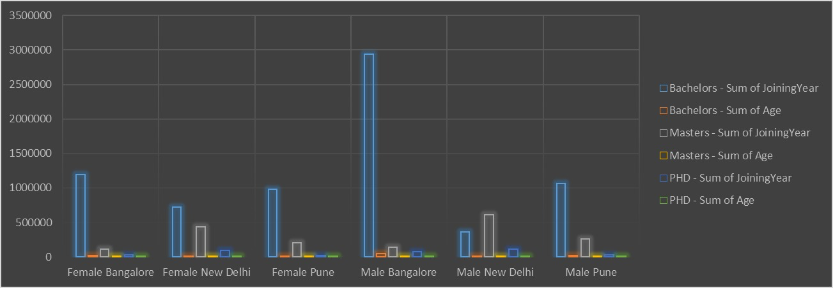
RESULTS
11

Slide 12
conclusion
Our employee gender analysis using Excel has provided valuable insights into the current state of gender demographics within our organization. The results highlight areas of strength and weakness, including:-
• Underrepresentation of women in certain departments and job titles
• Pay equity issues, with women earning less than men on average
• Disparities in promotion rates, indicating potential barriers to advancement for women.
These findings suggest opportunities for growth and improvement, enabling us to:-
• Develop targeted diversity and inclusion initiatives
• Address pay equity issues through salary adjustments
• Create mentorship programs to support women's career advancement

